Slide 1

SRM INSTITUTE OF SCIENCE AND TECHNOLOGY Ramapuram , Chennai – 600 089 DEPARTMENT OF COMPUTER SCIENCE AND ENGINEERING
18CSP109L- PROJECT
Bladder Tissue Classification in Multi-Domain Endoscopic Images using Deep Learning
BATCH NUMBER : J8
Team Members | Supervisor
KIRTAN YOGESHKUMAR GHELANI [RA2011003020037] YASH MISHRA [RA2011003020047] MIHIR SINGH YADAV [RA2011003020072] | NAME: Dr. S. S. Sathya

Slide 2
Agenda
Abstract
Scope and Motivation
Introduction
Literature Survey ( Table)
Objective
Problem Statement
Proposed Work
Architecture Diagram/Flow Diagram/Block Diagram
Novel idea
Modules
Module Description
Software & Hardware Requirements
References (Base paper hard copy to be submitted to the supervisor.)
Way forward towards Outcome (Research Paper/Patent)

Slide 3
ABSTRACT
Accurate classification of bladder tissue during Trans-Urethral Resection of Bladder Tumor (TURBT) procedures is vital for early cancer diagnosis and treatment improvement.
White Light Imaging (WLI) and Narrow Band Imaging (NBI) techniques aid in lesion detection, each providing distinct visual cues.
Integrating both techniques via computer vision methods could enhance endoscopic diagnosis.
However, challenges arise when annotations are limited to WLI, creating unpaired datasets between NBI and WLI domains.
In this study, our method leverages a ResNet50-based architecture for accurate classification. The approach comprises a teacher network trained on labelled WLI data and a multi-input student network.
We evaluate the classification performance using quantitative metrics and specialist validation. Our method achieves outstanding results on both the training and test sets. For the training set, we achieve a precision, recall, and F1-score of 0.96, 0.95, and 0.95, respectively, with an overall accuracy of 0.96. On the test set, our approach demonstrates a precision, recall, and F1-score of 0.82, 0.73, and 0.75, respectively, with an accuracy of 0.83.
These results highlight the robustness of our ResNet50-based approach in accurately classifying bladder tissue, even in the presence of limited annotations. This study underscores the potential of ResNet50-based bladder tissue classification in multidomain data, offering a promising avenue for improving diagnostic accuracy in clinical settings

Slide 4
Scope and Motivation
This project operates within the realm of medical image analysis, focusing specifically on the classification of bladder tissue.
It involves analyzing endoscopic images acquired from different imaging modalities during Trans-Urethral Resection of the Bladder Tumor procedures.
The goal of the project is to develop algorithms and methodologies capable of accurately categorizing bladder tissue based on visual data extracted from diverse imaging techniques, including White Light Imaging and Narrow Band Imaging.
By tackling the complexities associated with analyzing images from multiple domains during TURBT procedures, this project contributes to the enhancement of computer-aided diagnosis systems for the detection and classification of bladder cancer

Slide 5
Introduction
Urinary tract cancer poses significant challenges within oncology, encompassing a wide range of lesions from benign to potentially fatal neoplasms.
In 2021, there were approximately 164,000 reported cases worldwide, solidifying its position among the top 10 most frequently diagnosed malignancies.
Muscle Invasive Bladder Cancer (MIBC), an aggressive subtype originating from the bladder's inner lining, is particularly concerning due to its high propensity for metastasis, in contrast to the relatively less invasive Non-Muscle Invasive Bladder Cancer (NMIBC).
Diagnosis typically begins with cystoscopy, enabling direct visualization of the bladder's internal surface to detect abnormalities.
Subsequently, patients with suspicious tissue undergo Trans-Urethral Resection of the Bladder Tumor (TURBT), a pivotal surgical intervention involving endoscopic excision of visible tumor lesions. TURBT not only confirms BC diagnosis but also determines disease extent and guides treatment decisions.
Given the critical importance of accurate tissue classification during TURBT, there is an urgent need for advanced diagnostic tools and methodologies to improve the precision and efficiency of bladder cancer diagnosis and management.

Slide 6
Literature Survey
S.No. | Title of the Paper | Year | Journal/Conference Name | Inferences
1 | 2020 | Urinary tract infections: microbial pathogenesis, host–pathogen interactions and new treatment strategies | R. D. Klein and S. J. Hultgren | Misdiagnosis and inappropriate treatment
2 | 2021 | Sociodemographic factors and uncomplicated cystitis in women aged 15–50 years: a nationwide Swedish cohort registry study . | F. Jansåker, X. Li, and K. Sundquist | More Challenging and sometimes ineffective.
3 | 2019 | Using artificial intelligence to reduce diagnostic workload without compromising detection of urinary tract infections | R. J. Burton, M. Albur, M. Eberl, and S. M. Cuff | Reduce of effectiveness when deployed

Slide 7
Literature Survey
S.No. | Title of the Paper | Year | Journal/Conference Name | Inferences
4 | R. Yang et al., "Automatic recognition of bladder tumours using deep learning technology and its clinical application" | 2020 | The International Journal of Medical Robotics and Computer Assisted Surgery | validates the effectiveness of deep learning, particularly convolutional neural networks, in accurately identifying bladder cancer from cystoscopic images.
5 | A. Ikeda et al., "Support system of cystoscopic diagnosis for bladder cancer based on artificial intelligence" | 2020 | Journal of Endourology | Proposes a novel approach utilizing artificial intelligence (AI) to address diagnostic challenges in bladder neoplasia detection, augmenting conventional cystoscopy with a CNN-based tumor classifier.

Slide 8
Objective
This project aims to develop and implement an advanced computer-aided diagnosis (CAD) system tailored specifically for the classification of Bladder Cancer (BC) during Trans-Urethral Resection of the Bladder Tumor (TURBT) procedures.
Utilizing Deep Learning (DL) techniques, particularly ResNet50 and similar architectures, our goal is to create a robust framework capable of automatically analyzing endoscopic images for precise bladder tissue classification.
An important aspect of this project is addressing the challenge of limited annotations available in only one image domain, whether it's White Light Imaging (WLI) or Narrow Band Imaging (NBI).
By employing innovative algorithmic approaches and advanced DL methodologies like ResNet50-based classification, we aim to overcome this limitation and achieve accurate tissue classification across various imaging modalities, thereby improving diagnostic accuracy and enabling more effective patient management strategies.

Slide 9
Problem Statement
The visual categorization of Bladder Cancer (BC) poses significant challenges arising from the inherent intricacies of distinguishing between diverse tissue types.
One notable obstacle stems from the remarkable resemblances in the shapes of high-grade and low-grade tumor lesions, presenting a substantial hurdle to precise differentiation relying solely on visual examination.
Additionally, distinguishing between healthy tissue and non-tumor lesions introduces another layer of complexity into the diagnostic process.
While histological examination post-resection remains the benchmark for conclusive cancer diagnosis and grading, the dependence on this invasive procedure emphasizes the necessity for non-invasive imaging techniques capable of offering dependable insights into tissue pathology.
In this context, the amalgamation of cutting-edge imaging modalities such as Narrow Band Imaging (NBI) alongside traditional White Light Imaging (WLI) emerges as a promising strategy to augment tumor differentiation and enable more accurate diagnosis.
By harnessing the distinct contrast properties of NBI, medical practitioners can acquire clearer depiction of tissue morphology and vascular patterns, thereby enhancing the diagnostic precision and facilitating more informed treatment decisions.

Slide 10
Proposed Work
Our proposed system aims to tackle the intricate task of bladder tissue classification within the context of multi-domain images obtained from Trans-Urethral Resection of Bladder Tumor (TURBT) procedures. To address this challenge, we introduce a novel approach that leverages ResNet50 and similar deep learning architectures for classification tasks.
Initially, we deploy a ResNet50-based teacher network trained on annotated White Light Imaging (WLI) images to provide foundational knowledge for subsequent classification tasks. This network serves as a guiding mechanism for the learning process, leveraging the rich information encapsulated within the labeled WLI dataset.
In summary, our proposed system presents an innovative and comprehensive approach to bladder tissue classification, leveraging advanced deep learning techniques, particularly ResNet50, to address the challenges associated with multi-domain endoscopic imaging data.

Slide 11
Proposed Work
ResNet-Based architecture:
This component serves as the backbone of the architecture, leveraging the ResNet50 model pretrained on ImageNet datasets for feature extraction. By utilizing transfer learning, the feature extractor can capture high-level features from bladder images, providing rich representations for subsequent classification tasks.
The pretrained ResNet50 model offers a robust foundation for feature extraction, enabling the system to effectively learn discriminative features from the input images.

Slide 12
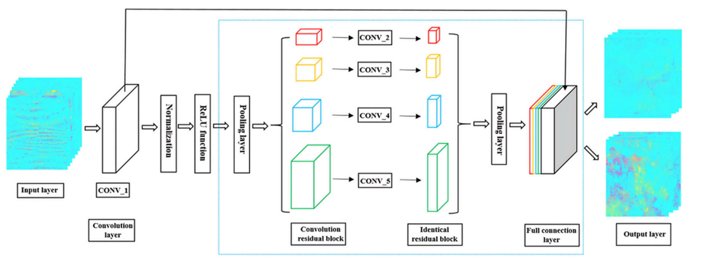
Proposed Work
Architecture Diagram:

Slide 13
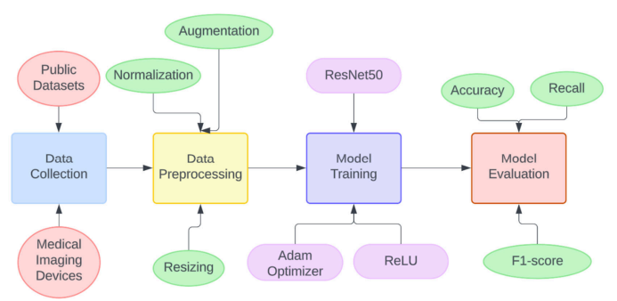
Proposed Work
Data Flow Diagram:

Slide 14
Software & Hardware Requirements
Software Specification:
Operating System: Windows 10 or higher
Machine Learning Plugins: TensorFlow, PyTorch
Deep Learning Frameworks: PyTorch
Image Processing Libraries: OpenCV, scikit-image
Data Analysis and Visualization: Pandas, NumPy, Matplotlib, Seaborn
Model Evaluation Metrics: Torchmetrics, Scikit-learn
Development Environment: Python 3.x
Additional Libraries: tqdm

Slide 15
Software & Hardware Requirements
Hardware Specification:
Processor: Intel i5 12500
RAM: 16GB
Graphics Card: Nvidia RTX 3060
Storage: 1TB SSD
Additional Components: Other computational resources for Deep Learning (DL) model training and inference.

Slide 16
Future Work
Future work will focus on several enhancements to further validate and improve the proposed method:
Multi-Center Data Validation:
Expanding the validation of the method using data from multiple centers will enhance its generalization capability and robustness across diverse clinical settings.
Incorporating data from different medical institutions will help assess the method's performance under varied imaging conditions and patient populations, thereby increasing its reliability and applicability in real-world scenarios.
Utilization of Generative Adversarial Networks (GANs):
To further refine tissue classification, the incorporation of Generative Adversarial Networks (GANs) presents a promising avenue.
GANs can generate synthetic images that closely resemble real bladder tissue samples, facilitating data augmentation and diversification of the training dataset. By exposing the model to a broader spectrum of bladder tissue variations, GANs can enhance the model's robustness and generalization capabilities, thereby mitigating the risk of overfitting and improving performance on unseen data

Slide 17
References
[1] Al-Danakh, A., Safi, M., Al-Radhi, M., Zhu, X., & Yang, D. (2022).Surgery improves overall and cancer-specific survival of rare urinary cancers; population - Based study. Surgical Oncology, 44, 101807. https://doi.org/10.1016/j.suronc.2022.101807
[2] Koul, A., Kumar, Y., Gupta, A. (2022, October 10). A Study on Bladder Cancer Detection using AI-based Learning Techniques. 2022 2nd International Conference on Technological Advancements in Computational Sciences (ICTACS). http://dx.doi.org/10.1109/ictacs56270.2022.9988462
[3] Chang, T. C., Shkolyar, E., Del Giudice, F., Eminaga, O., Lee, T., Laurie, M., Seufert, C., Jia, X., Mach, K. E., Xing, L., Liao, J. C. (2023). Real-time detection of bladder cancer using augmented cystoscopy with deep learning: A pilot study. Journal of Endourology. https://doi.org/10.1089/end.2023.0056
[4] Li, S., Xin, K., Pan, S., Wang, Y., Zheng, J., Li, Z., Liu, X., Liu, B., Xu, Z. Chen, X. (2023a). Blood-based liquid biopsy: Insights into early detection, prediction, and treatment monitoring of bladder cancer. Cellular amp; Molecular Biology Letters, 28(1). https://doi.org/10.1186/s11658-023-00442-z
[5] Genega, E. (2023). Staging of urothelial carcinoma of the urinary bladder and urethra. In Uropathology (pp. 273–274). Elsevier. http://doi.org/10.1016/b978-0-323-65395-4.00130-5

Slide 18
References
[6] Deng, Z., Dong, W., Xiong, S., Jin, D., Zhou, H., Zhang, L., Xie, L., Deng, Y., Xu, R., Fan, B. (2023). Machine learning models combining computed tomography semantic features and selected clinical variables for accurate prediction of the pathological grade of bladder cancer. Frontiers in Oncology, 13. https://doi.org/10.3389/fonc.2023.1166245
[7] Lazo, J. F. (n.d.). Semi-supervised bladder tissue classification in multi-domain endoscopic images https://doi.org/10.1109/tbme.2023.3265679/mm1

